Slide 1

Fundamentals of Database Systems
Seventh Edition
Chapter 14
Basics of Functional Dependencies and Normalization for Relational Databases
Copyright © 2016, 2011, 2007 Pearson Education, Inc. All Rights Reserved
Notes:
If this PowerPoint presentation contains mathematical equations, you may need to check that your computer has the following installed:
1) MathType Plugin
2) Math Player (free versions available)
3) NVDA Reader (free versions available)

Slide 2
Learning Objectives (1 of 3)
14.1 Informal Design Guidelines for Relational Databases
14.1.1 Semantics of the Relation Attributes
14.1.2 Redundant Information in Tuples and Update Anomalies
14.1.3 Null Values in Tuples
14.1.4 Spurious Tuples
14.2 Functional Dependencies (F D s)
14.2.1 Definition of Functional Dependency

Slide 3
Learning Objectives (2 of 3)
14.3 Normal Forms Based on Primary Keys
14.3.1 Normalization of Relations
14.3.2 Practical Use of Normal Forms
14.3.3 Definitions of Keys and Attributes Participating in Keys
14.3.4 First Normal Form
14.3.5 Second Normal Form
14.3.6 Third Normal Form
14.4 General Normal Form Definitions for 2N F and 3N F (For Multiple Candidate Keys)
14.5 B C N F (Boyce-Codd Normal Form)

Slide 4
Learning Objectives (3 of 3)
14.6 Multivalued Dependency and Fourth Normal Form
14.7 Join Dependencies and Fifth Normal Form

Slide 5
14.1 Informal Design Guidelines for Relational Databases (1 of 2)
What is relational database design?
The grouping of attributes to form “good” relation schemas
Two levels of relation schemas
The logical “user view” level
The storage “base relation” level
Design is concerned mainly with base relations
What are the criteria for “good” base relations?

Slide 6
14.1 Informal Design Guidelines for Relational Databases (2 of 2)
We first discuss informal guidelines for good relational design
Then we discuss formal concepts of functional dependencies and normal forms
1N F (First Normal Form)
2N F (Second Normal Form)
3N F (Third Noferferferfewrmal Form)
B C N F (Boyce-Codd Normal Form)
Additional types of dependencies, further normal forms, relational design algorithms by synthesis are discussed in Chapter 15

Slide 7
14.1.1 Semantics of the Relational Attributes Must Be Clear
Guideline 1: Informally, each tuple in a relation should represent one entity or relationship instance. (Applies to individual relations and their attributes).
Attributes of different entities (EMPLOYEEs, DEPARTMENTs, PROJECTs) should not be mixed in the same relation
Only foreign keys should be used to refer to other entities
Entity and relationship attributes should be kept apart as much as possible.
Bottom Line: Design a schema that can be explained easily relation by relation. The semantics of attributes should be easy to interpret.

Slide 8
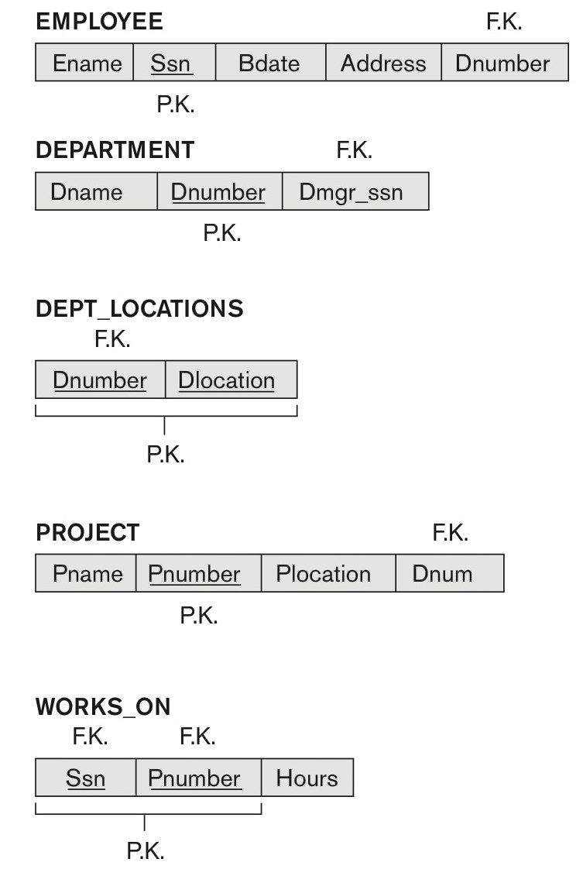
Figure 14.1 A Simplified COMPANY Relational Database Schema

Slide 9
14.1.2 Redundant Information in Tuples and Update Anomalies
Information is stored redundantly
Wastes storage
Causes problems with update anomalies
Insertion anomalies
Deletion anomalies
Modification anomalies

Slide 10
Example of an Update Anomaly
Consider the relation:
Update Anomaly:
Changing the name of project number P1 from “Billing” to “Customer-Accounting” may cause this update to be made for all 100 employees working on project P1.

Slide 11
Example of an Insert Anomaly
Consider the relation:
Insert Anomaly:
Cannot insert a project unless an employee is assigned to it.
Conversely
Cannot insert an employee unless an he/she is assigned to a project.

Slide 12
Example of a Delete Anomaly
Consider the relation:
Delete Anomaly:
When a project is deleted, it will result in deleting all the employees who work on that project.
Alternately, if an employee is the sole employee on a project, deleting that employee would result in deleting the corresponding project.

Slide 13
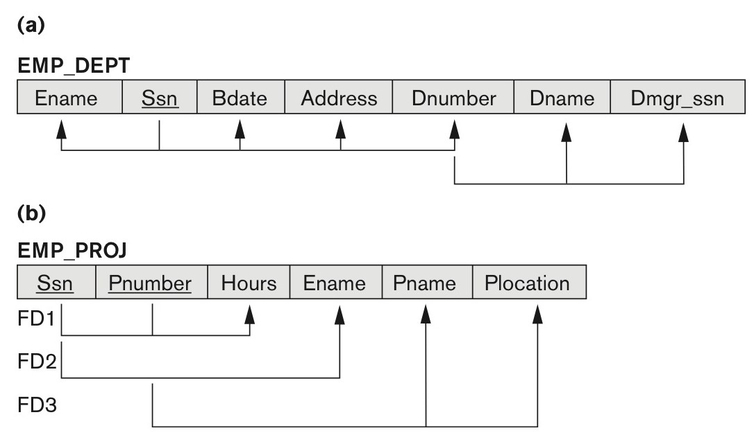
Figure 14.3 Two Relation Schemas Suffering from Update Anomalies
(a) EMP_DEPT and (b) EMP_PROJ

Slide 14
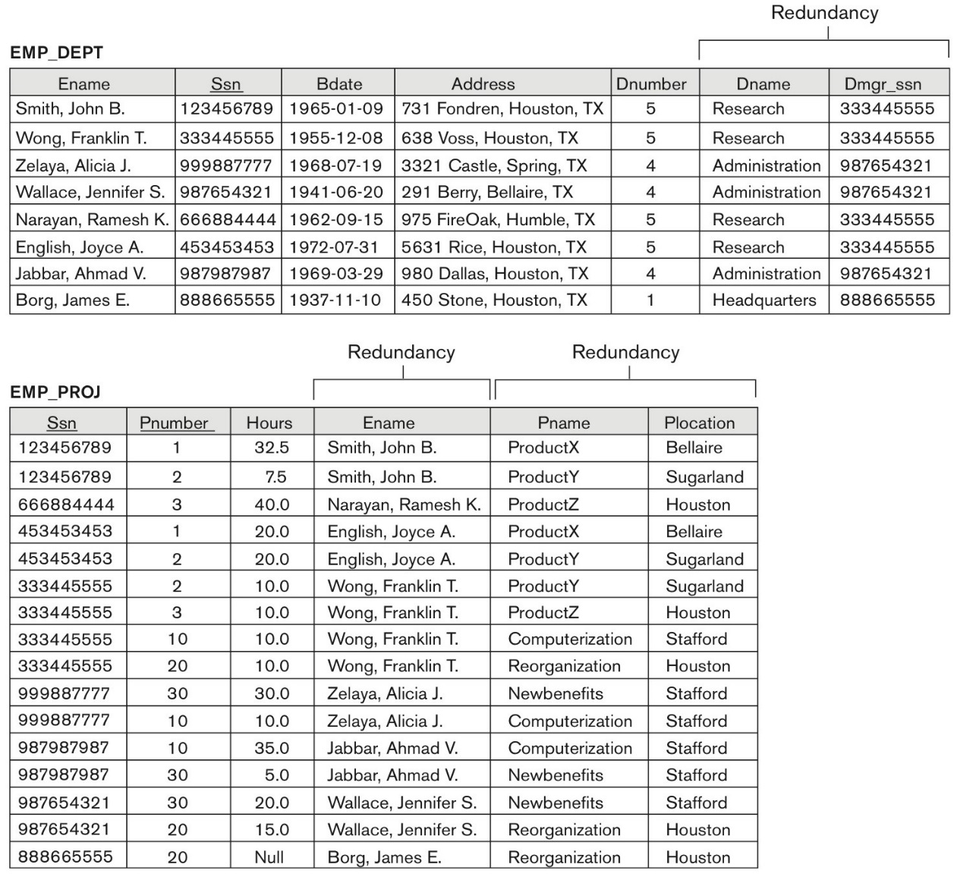
Figure 14.4 Sample States For EMP_DEPT and E MP_PROJ
Sample states for EMP_DEPT and EMP_PROJ resulting from applying NATURAL JOIN to the relations in Figure 14.2. These may be stored as base relations for performance reasons.

Slide 15
Guideline for Redundant Information in Tuples and Update Anomalies
Guideline 2:
Design a schema that does not suffer from the insertion, deletion and update anomalies.
If there are any anomalies present, then note them so that applications can be made to take them into account.

Slide 16
14.1.3 Null Values in Tuples
Guideline 3:
Relations should be designed such that their tuples will have as few NULL values as possible
Attributes that are NULL frequently could be placed in separate relations (with the primary key)
Reasons for nulls:
Attribute not applicable or invalid
Attribute value unknown (may exist)
Value known to exist, but unavailable

Slide 17
14.1.4 Generation of Spurious Tuples – Avoid at Any Cost (1 of 2)
Bad designs for a relational database may result in erroneous results for certain JOIN operations
The “lossless join” property is used to guarantee meaningful results for join operations
Guideline 4:
The relations should be designed to satisfy the lossless join condition.
No spurious tuples should be generated by doing a natural-join of any relations.

Slide 18
14.1.4 Generation of Spurious Tuples – Avoid at Any Cost (2 of 2)
There are two important properties of decompositions:
a) Non-additive or losslessness of the corresponding join
b) Preservation of the functional dependencies.
Note that:
Property (a) is extremely important and cannot be sacrificed.
Property (b) is less stringent and may be sacrificed. (See Chapter 15).

Slide 19
14.2 Functional Dependencies
Functional dependencies (F D s)
Are used to specify formal measures of the “goodness” of relational designs
And keys are used to define normal forms for relations
Are constraints that are derived from the meaning and interrelationships of the data attributes
A set of attributes X functionally determines a set of attributes Y if the value of X determines a unique value for Y

Slide 20
14.2.1 Defining Functional Dependencies
X → Y holds if whenever two tuples have the same value for X, they must have the same value for Y
For any two tuples t₁ and t₂ in any relation instance
X → Y in R specifies a constraint on all relation instances r (R)
Written as X → Y can be displayed graphically on a relation schema as in Figures. (denoted by the arrow:).
F D s are derived from the real-world constraints on the attributes

Slide 21
Examples of F D Constraints (1 of 2)
Social security number determines employee name
S S N → ENAME
Project number determines project name and location
PNUMBER → {PNAME, PLOCATION}
Employee s s n and project number determines the hours per week that the employee works on the project
{SSN, PNUMBER} → HOURS

Slide 22
Examples of F D Constraints (2 of 2)
An F D is a property of the attributes in the schema R
The constraint must hold on every relation instance r(R)
If K is a key of R, then K functionally determines all attributes in R
(since we never have two distinct tuples with t₁[K]=t₂[K])

Slide 23
Defining F D s From Instances
Note that in order to define the F D s, we need to understand the meaning of the attributes involved and the relationship between them.
An F D is a property of the attributes in the schema R
Given the instance (population) of a relation, all we can conclude is that an F D may exist between certain attributes.
What we can definitely conclude is – that certain F D s do not exist because there are tuples that show a violation of those dependencies.

Slide 24
Figure 14.7 Ruling Out F D s
Note that given the state of the TEACH relation, we can say that the F D: Text → Course may exist. However, the F D s Teacher → Course, Teacher →Text and
Couse → Text are ruled out.
TEACH
Teacher | Course | Text
Smith | Data Structures | Bartram
Smith | Data Management | Martin
Hall | Compilers | Hoffman
Brown | Data Structures | Horowitz

Slide 25
Figure 14.8 What F D s May Exist?
A relation A relation R(A, B, C, D) with its extension.
Which F Ds may exist in this relation?
A | B | C | D
a1 | b1 | c1 | d1
a1 | b2 | c2 | d2
a2 | b2 | c2 | d3
a3 | b3 | c4 | d3

Slide 26
14.3 Normal Forms Based on Primary Keys
3.1 Normalization of Relations
3.2 Practical Use of Normal Forms
3.3 Definitions of Keys and Attributes Participating in Keys
3.4 First Normal Form
3.5 Second Normal Form
3.6 Third Normal Form

Slide 27
14.3.1 Normalization of Relations (1 of 2)
Normalization:
The process of decomposing unsatisfactory “bad” relations by breaking up their attributes into smaller relations
Normal form:
Condition using keys and F D s of a relation to certify whether a relation schema is in a particular normal form

Slide 28
14.3.1 Normalization of Relations (2 of 2)
2N F, 3N F, B C N F
based on keys and F D s of a relation schema
4N F
based on keys, multi-valued dependencies: M V D s;
5N F
based on keys, join dependencies: J D s
Additional properties may be needed to ensure a good relational design (lossless join, dependency preservation; see Chapter 15)

Slide 29
14.3.2 Practical Use of Normal Forms
Normalization is carried out in practice so that the resulting designs are of high quality and meet the desirable properties
The practical utility of these normal forms becomes questionable when the constraints on which they are based are hard to understand or to detect
The database designers need not normalize to the highest possible normal form
(usually up to 3N F and B C N F. 4N F rarely used in practice.)
Denormalization:
The process of storing the join of higher normal form relations as a base relation—which is in a lower normal form

Slide 30
14.3.3 Definitions of Keys and Attributes Participating in Keys (1 of 2)
A superkey of a relation schema is
a set of attributes S subset-of R with the property that no two tuples t₁ and t₂ in any legal relation state r of R will have
A key K is a superkey with the additional property that removal of any attribute from K will cause K not to be a superkey any more.

Slide 31
14.3.3 Definitions of Keys and Attributes Participating in Keys (2 of 2)
If a relation schema has more than one key, each is called a candidate key.
One of the candidate keys is arbitrarily designated to be the primary key, and the others are called secondary keys.
A Prime attribute must be a member of some candidate key
A Nonprime attribute is not a prime attribute—that is, it is not a member of any candidate key.

Slide 32
14.3.4 First Normal Form
Disallows
composite attributes
multivalued attributes
nested relations; attributes whose values for an individual tuple are non-atomic
Considered to be part of the definition of a relation
Most R D B M S s allow only those relations to be defined that are in First Normal Form

Slide 33
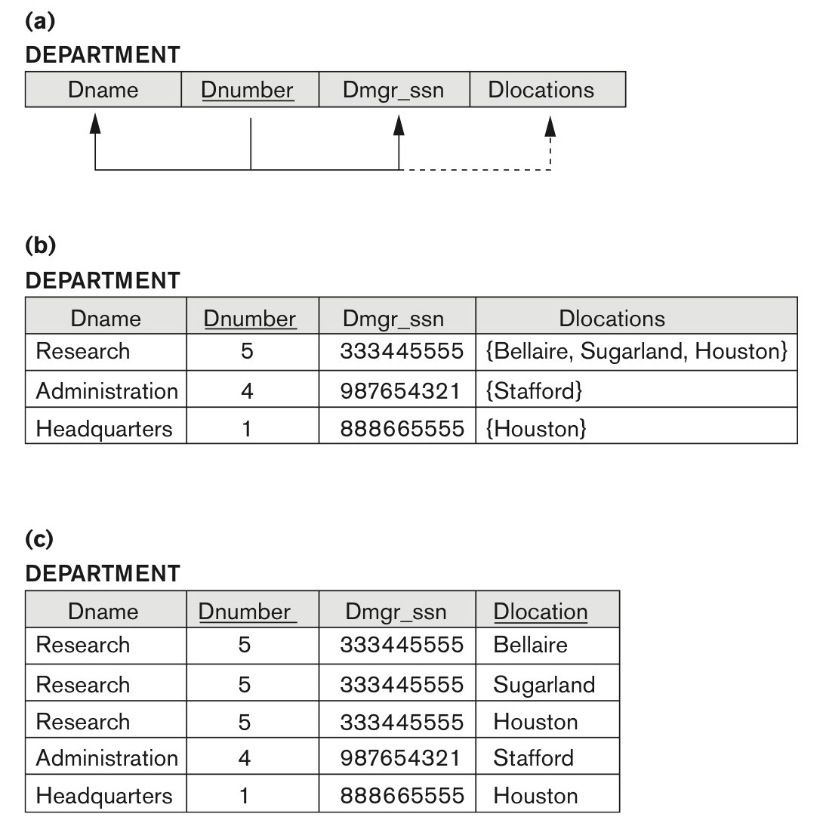
Figure 14.9 Normalization into 1N F
(a) A relation schema that is not in 1N F. (b) Sample state of relation DEPARTMENT. (c) 1N F version of the same relation with redundancy.

Slide 34

Figure 14.10 Normalizing Nested Relations into 1N F
(a) Schema of the EMP_PROJ relation with a nested relation attribute PROJS. (b) Sample extension of the EMP_PROJ relation showing nested relations within each tuple. (c) Decomposition of EMP_PROJ into relations EMP_PROJ1 and EMP_PROJ2 by propagating the primary key.

Slide 35
14.3.5 Second Normal Form (1 of 2)
Uses the concepts of F D s, primary key
Definitions
Prime attribute: An attribute that is member of the primary key K
Full functional dependency: a F D Y → Z where removal of any attribute from Y means the F D does not hold any more
Examples:
{S S N, PNUMBER} → HOURS is a full F D since neither S S N → HOURS nor PNUMBER → HOURS hold
{S S N, PNUMBER} → ENAME is not a full F D (it is called a partial dependency ) since S S N → ENAME also holds

Slide 36
14.3.5 Second Normal Form (2 of 2)
A relation schema R is in second normal form (2N F) if every non-prime attribute A in R is fully functionally dependent on the primary key
R can be decomposed into 2N F relations via the process of 2N F normalization or “second normalization”

Slide 37
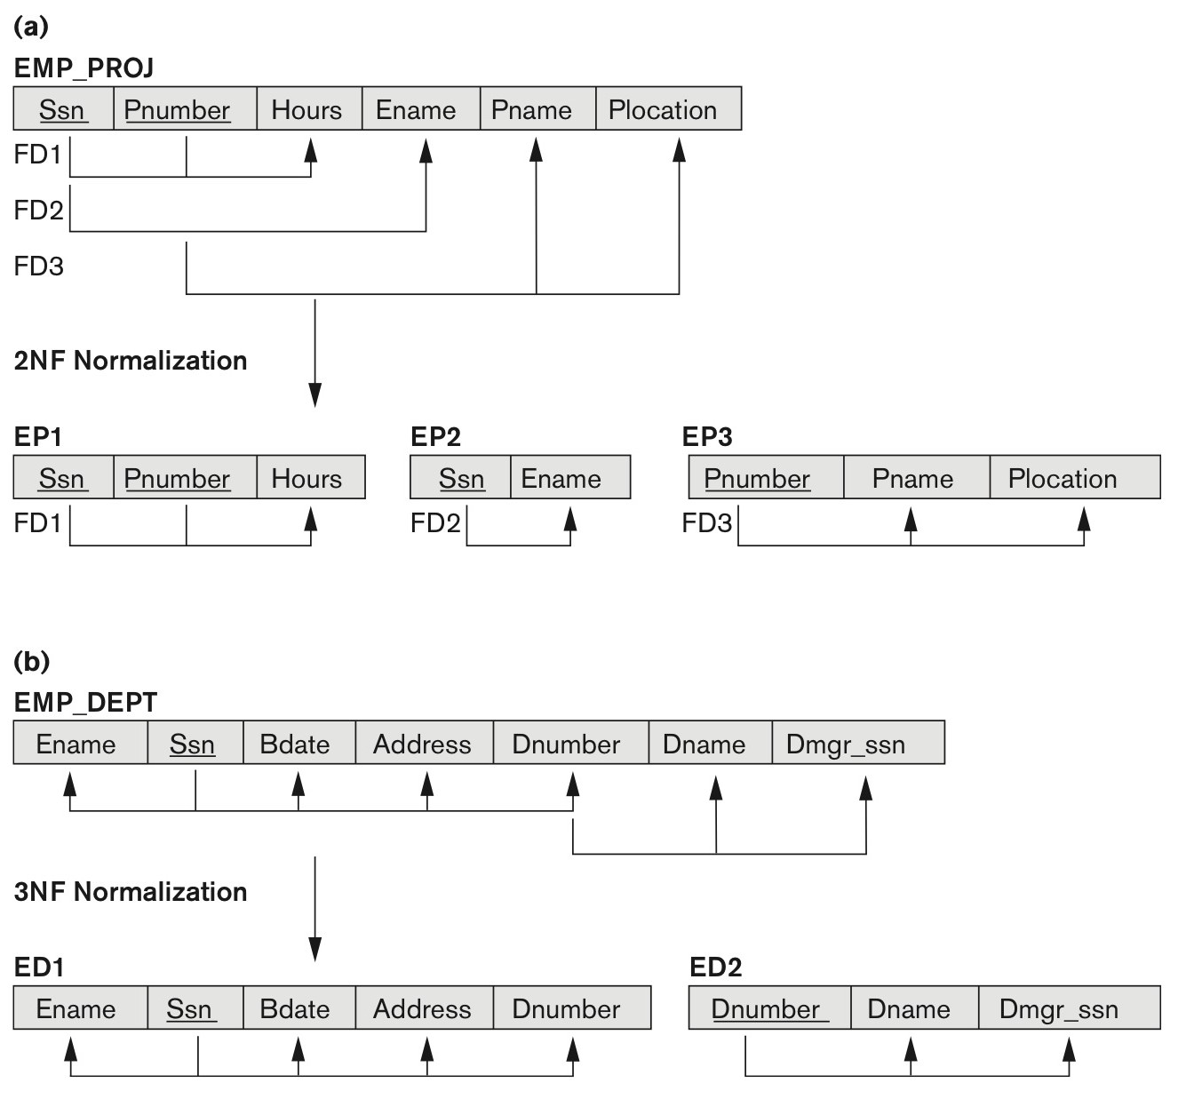
Figure 14.11 Normalizing into 2N F and 3N F
(a) Normalizing E M P_PROJ into 2N F relations. (b) Normalizing E M P_DEPT into 3N F relations.

Slide 38
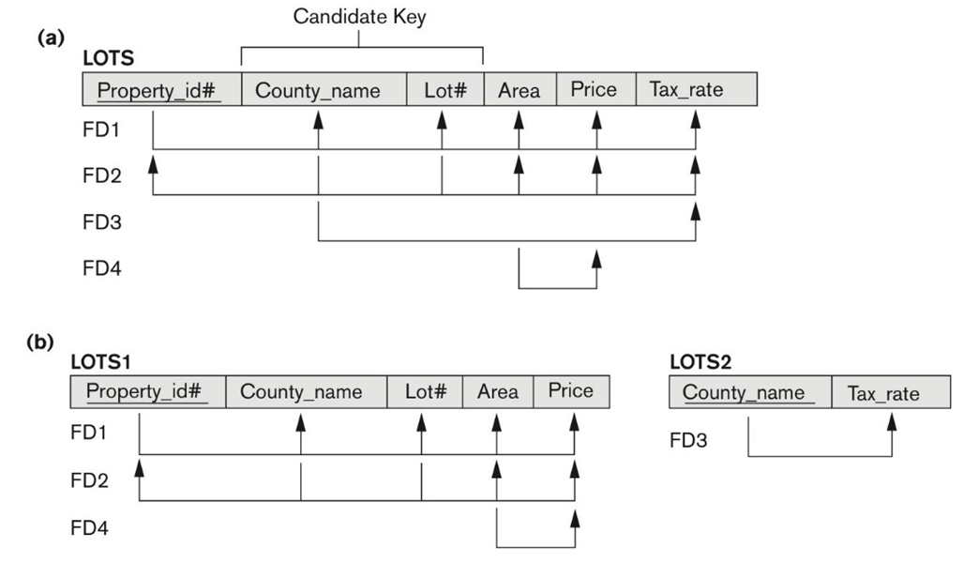
Figure 14.12 Normalization into 2N F and 3N F (1 of 2)
(a) The LOTS relation with its functional dependencies F D1 through F D4. (b) Decomposing into the 2N F relations LOTS1 and LOTS2.

Slide 39
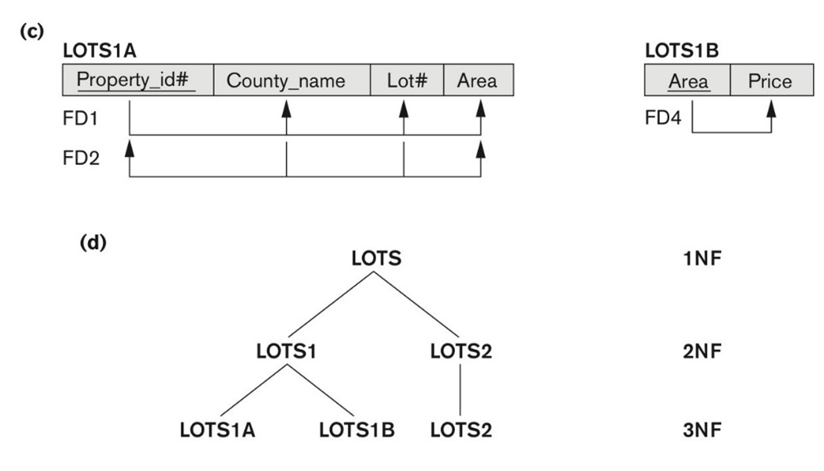
Figure 14.12 Normalization into 2N F and 3N F (2 of 2)
(c) Decomposing LOTS1 into the 3N F relations LOTS 1A and LOTS 1B. (d) Progressive normalization of LOTS into a 3N F design.

Slide 40
14.3.6 Third Normal Form (1 of 2)
Definition:
Transitive functional dependency: a F D X → Z that can be derived from two F D s X → Y and Y → Z
Examples:
S S N → D M G R S S N is a transitive F D
Since S S N → D NUMBER and D NUMBER → D M G R S S N hold
S S N → ENAME is non-transitive
Since there is no set of attributes X where S S N → X and X → ENAME

Slide 41
14.3.6 Third Normal Form (2 of 2)
A relation schema R is in third normal form (3N F) if it is in 2N F and no non-prime attribute A in R is transitively dependent on the primary key
R can be decomposed into 3N F relations via the process of 3N F normalization
NOTE:
In X → Y and Y → Z, with X as the primary key, we consider this a problem only if Y is not a candidate key.
When Y is a candidate key, there is no problem with the transitive dependency .
E.g., Consider EMP (S S N, Emp#, Salary ).
Here, S S N → Emp# → Salary and Emp# is a candidate key.

Slide 42
Normal Forms Defined Informally
1st normal form
All attributes depend on the key
2nd normal form
All attributes depend on the whole key
3rd normal form
All attributes depend on nothing but the key

Slide 43
14.4 General Normal Form Definitions (For Multiple Keys)
The above definitions consider the primary key only
The following more general definitions take into account relations with multiple candidate keys
Any attribute involved in a candidate key is a prime attribute
All other attributes are called non-prime attributes.

Slide 44
14.4.1 General Definition of 2N F (For Multiple Candidate Keys)
A relation schema R is in second normal form (2N F) if every non-prime attribute A in R is fully functionally dependent on every key of R
In Figure 14.12 the F D
County_name → Tax_rate violates 2N F.
So second normalization converts LOTS into

Slide 45
14.4.2 General Definition of Third Normal Form
Definition:
Superkey of relation schema R - a set of attributes S of R that contains a key of R
A relation schema R is in third normal form (3N F) if whenever a F D X → A holds in R, then either:
(a) X is a superkey of R, or
(b) A is a prime attribute of R
LOTS1 relation violates 3N F because
Area → Price ; and Area is not a superkey in LOTS1. (see Figure 14.12).

Slide 46
14.4.3 Interpreting the General Definition of Third Normal Form (1 of 2)
Consider the 2 conditions in the Definition of 3N F:
A relation schema R is in third normal form (3N F) if whenever a F D X → A holds in R, then either:
(a) X is a superkey of R, or
(b) A is a prime attribute of R
Condition (a) catches two types of violations :
one where a prime attribute functionally determines a non-prime attribute. This catches 2N F violations due to non-full functional dependencies.
second, where a non-prime attribute functionally determines a non-prime attribute. This catches 3N F violations due to a transitive dependency.

Slide 47
14.4.3 Interpreting the General Definition of Third Normal Form (2 of 2)
Alternative Definition of 3N F: We can restate the definition as:
A relation schema R is in third normal form (3N F) if every non-prime attribute in R meets both of these conditions:
It is fully functionally dependent on every key of R
It is non-transitively dependent on every key of R
Note that stated this way, a relation in 3N F also meets the requirements for 2N F.
The condition (b) from the last slide takes care of the dependencies that “slip through” (are allowable to) 3N F but are “caught by” B C N F which we discuss next.

Slide 48
14.5 B C N F (Boyce-Codd Normal Form)
A relation schema R is in Boyce-Codd Normal Form (B C N F) if whenever an F D X → A holds in R, then X is a superkey of R
Each normal form is strictly stronger than the previous one
Every 2N F relation is in 1N F
Every 3N F relation is in 2N F
Every B C N F relation is in 3N F
There exist relations that are in 3N F but not in B C N F
Hence B C N F is considered a stronger form of 3N F
The goal is to have each relation in B C N F (or 3N F)

Slide 49
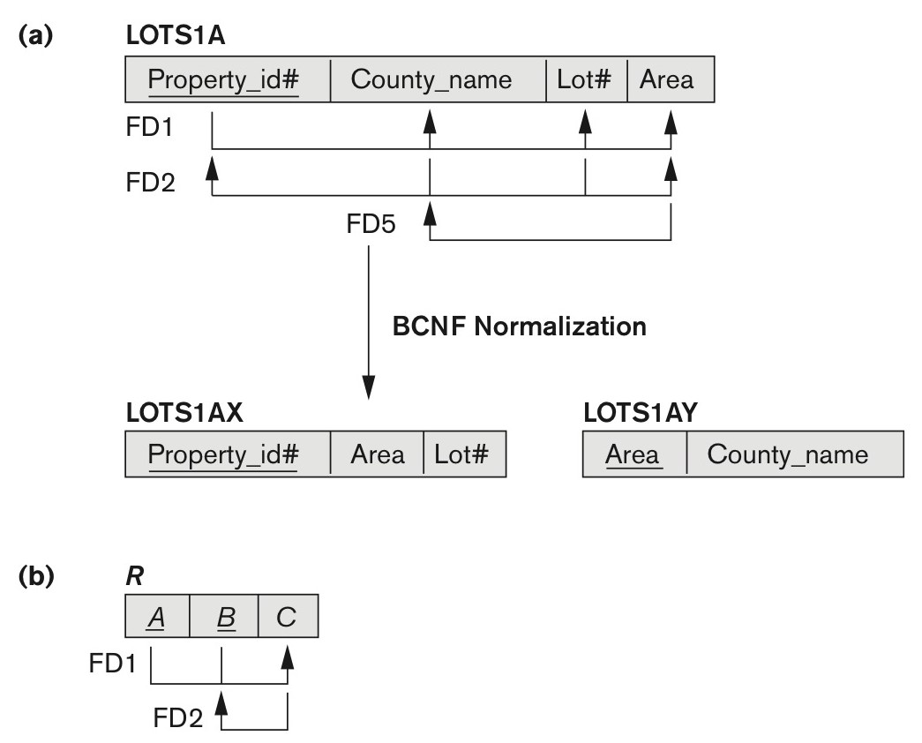
Figure 14.13 Boyce-Codd Normal Form
(a) B C N F normalization of LOTS 1A with the functional dependency F D2 being lost in the decomposition. (b) A schematic relation with F Ds; it is in 3N F, but not in B C N F due to the f.d. C → B

Slide 50
Figure 14.14 A Relation Teach That is in 3N F but Not in B C N F
TEACH
Student | Course | Instructor
Narayan | Database | Mark
Smith | Database | Navathe
Smith | Operating Systems | Ammar
Smith | Theory | Schulman
Wallace | Database | Mark
Wallace | Operating Systems | Ahamad
Wong | Database | Omiecinski
Zelaya | Database | Navathe
Narayan | Operating Systems | Ammar

Slide 51
Achieving the B C N F by Decomposition (1 of 2)
Two F D s exist in the relation TEACH:
f d1: { student, course} → instructor
f d2: instructor → course
{student, course} is a candidate key for this relation and that the dependencies shown follow the pattern in Figure 14.13 (b).
So this relation is in 3N F but not in B C N F
A relation NOT in B C N F should be decomposed so as to meet this property, while possibly forgoing the preservation of all functional dependencies in the decomposed relations.
(See Algorithm 15.3)

Slide 52
Achieving the B C N F by Decomposition (2 of 2)
Three possible decompositions for relation TEACH
D1: {student, instructor} and {student, course}
D2: {course, instructor} and {course, student}
D3: {instructor, course} and {instructor, student} ✓
All three decompositions will lose f d1.
We have to settle for sacrificing the functional dependency preservation. But we cannot sacrifice the non-additivity property after decomposition.
Out of the above three, only the 3rd decomposition will not generate spurious tuples after join. (and hence has the non-additivity property).
A test to determine whether a binary decomposition (decomposition into two relations) is non-additive (lossless) is discussed under Property N J B on the next slide. We then show how the third decomposition above meets the property.

Slide 53
Test for Checking Non-Additivity of Binary Relational Decompositions (1 of 2)
Testing Binary Decompositions for Lossless Join (Non-additive Join) Property
Binary Decomposition: Decomposition of a relation R into two relations.
PROPERTY N J B (non-additive join test for binary decompositions): A decomposition
of R has the lossless join property with respect to a set of functional dependencies F on R if and only if either
,
,

Slide 54
Test for Checking Non-Additivity of Binary Relational Decompositions (2 of 2)
If you apply the N J B test to the 3 decompositions of the TEACH relation:
D1 gives Student → Instructor or Student → Course, none of which is true.
D2 gives Course → Instructor or Course → Student, none of which is true.
However, in D3 we get Instructor → Course or Instructor → Student.
Since Instructor → Course is indeed true, the N J B property is satisfied and D3 is determined as a non-additive (good) decomposition.

Slide 55
General Procedure for Achieving B C N F When a Relation Fails B C N F
Here we make use the algorithm from Chapter 15 (Algorithm 15.5):
Let R be the relation not in B C N F, let X be a subset-of R, and let X → A be the F D that causes a violation of B C N F. Then R may be decomposed into two relations:
(i) R – A and
If either R – A or
is not in B C N F, repeat the process.
Note that the f.d. that violated B C N F in TEACH was Instructor → Course. Hence its B C N F decomposition would be :
which gives
the relations: (Instructor, Student) and (Instructor, Course) that we obtained before in decomposition D3.

Slide 56

14.6 Multivalued Dependencies and Fourth Normal Form (1 of 2)
Definition:
A multivalued dependency (M V D) X
Y specified on relation schema R, where X and Y are both subsets of R, specifies the following constraint on any relation state r of R: If two tuples t₁ and t₂ exist in r such that
then two tuples t₃ and t₄ should also exist in r with the following properties, where we use Z to denote
An M V D X
Y in R is called a trivial M V D if (a) Y is a subset of X, or (b)

Slide 57
14.6 Multivalued Dependencies and Fourth Normal Form (2 of 2)
Definition:
A relation schema R is in 4N F with respect to a set of dependencies F (that includes functional dependencies and multivalued dependencies) if, for every nontrivial multivalued dependency
X is a superkey for R.
is the (complete) set of all dependencies (functional or multivalued) that will hold in every relation state r of R that satisfies F. It is also called the closure of F.
Note:

Slide 58
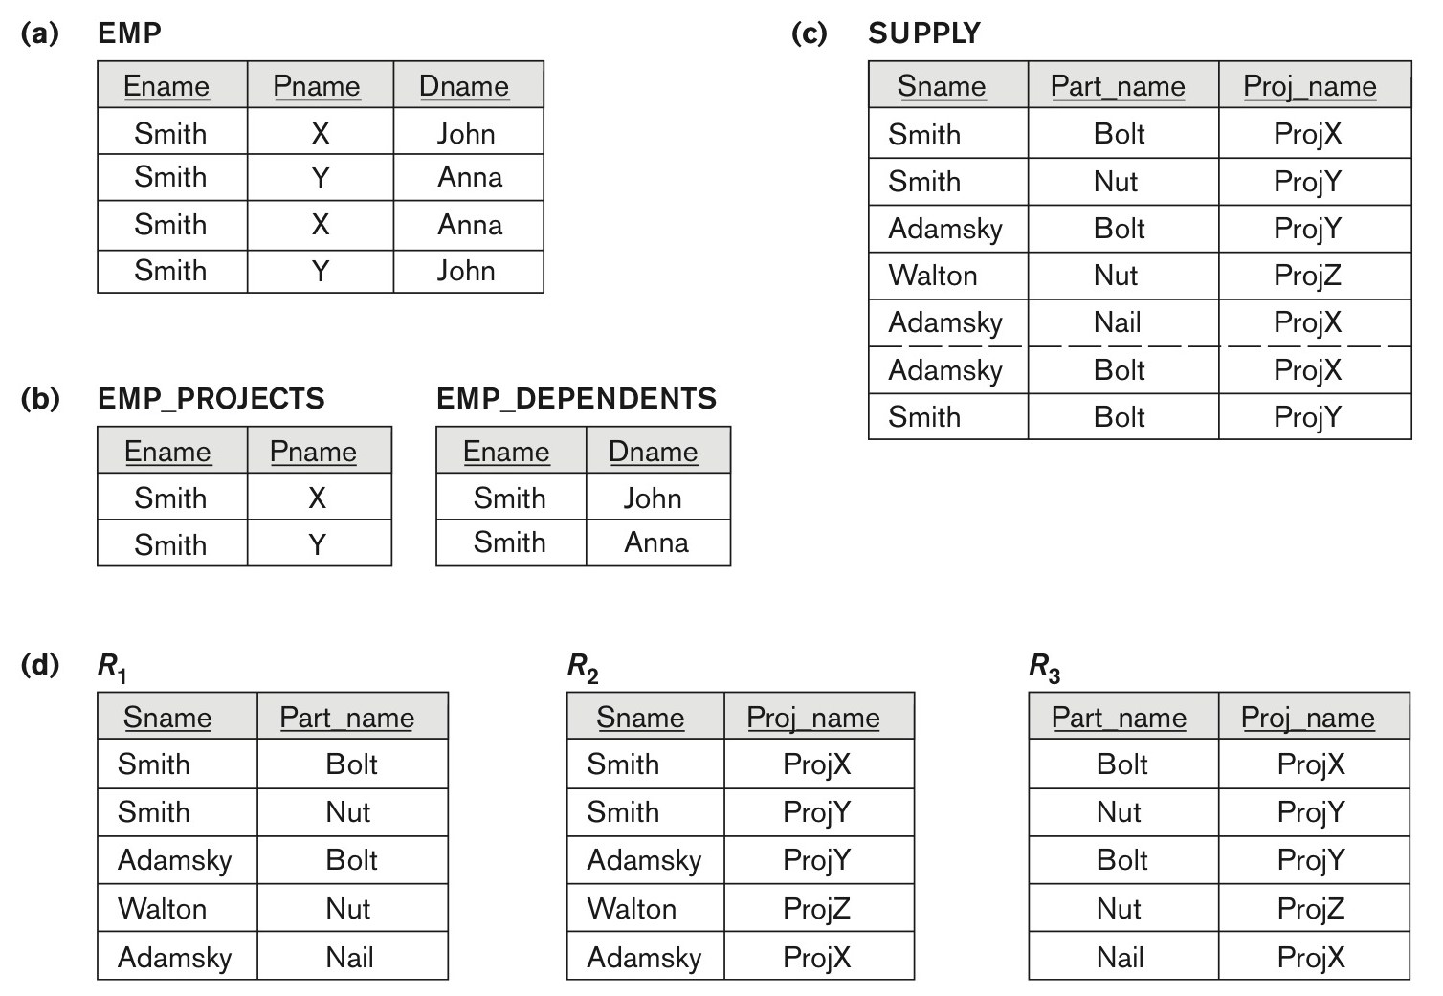
Figure 14.15 Fourth and Fifth Normal Forms
(a) The EMP relation with two M V D s:
Dname. (b) Decomposing the EMP relation into two 4N F relations EMP_PROJECTS and EMP_DEPENDENTS. (c) The relation SUPPLY with no M V D s is in 4N F but not in 5N F if it has the J D(R₁, R₂, R₃). (d) Decomposing the relation SUPPLY into the 5N F relations R₁, R₂, R₃.

Slide 59
14.7 Join Dependencies and Fifth Normal Form (1 of 2)
Definition:
A join dependency (J D), denoted by
specified on relation schema R, specifies a constraint on the states r of R.
The constraint states that every legal state r of R should have a non-additive join decomposition into R₁, R₂, ..., R_{n}; that is, for every such r we have
Note: an M V D is a special case of a J D where n = 2.
A join dependency
specified on relation schema R, is a trivial J D if one of the relation schemas R_{i} in
is equal to R.

Slide 60
14.7 Join Dependencies and Fifth Normal Form (2 of 2)
Definition:
A relation schema R is in fifth normal form (5N F) (or Project-Join Normal Form (P J N F)) with respect to a set F of functional, multivalued, and join dependencies if,
for every nontrivial join dependency
(that is, implied by F),
every R_{i} is a superkey of R.
Discovering join dependencies in practical databases with hundreds of relations is next to impossible. Therefore, 5N F is rarely used in practice.

Slide 61
Chapter Summary
Informal Design Guidelines for Relational Databases
Functional Dependencies (F D s)
Normal Forms (1N F, 2N F, 3N F)Based on Primary Keys
General Normal Form Definitions of 2N F and 3N F (For Multiple Keys)
B C N F (Boyce-Codd Normal Form)
Fourth and Fifth Normal Forms

Slide 62

Copyright

